Slide 1
Computer Engineering 12 Class 20
Instructor: Yuhong Liu
Office: Bannan 324 F
Email: yhliu@scu.edu
Tel: 408-551-3513

Slide 2
A Brief Review
Linear list: each element can have only one successor
Queue, stack
Non-linear list: each element can have more than one successors
Tree: Each element (i.e., node) can have only one predecessor
General tree
Binary tree
Binary Search tree
AVL tree
Binary heap
Graph: Each element can have more than one predecessor

Slide 3
Trees & Graphs
A tree is a collection of nodes in which each node has at most one predecessor (the parent) but arbitrarily many successors (the children).
A graph is a collection of nodes in which each node can have an arbitrary number of both predecessors and successors.

Slide 4
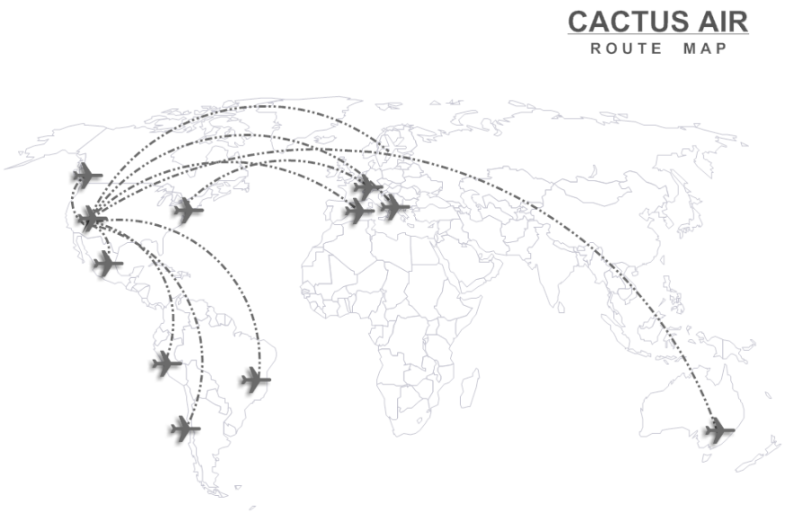
Graphs - Categories
Directed & Undirected Graph
Weighted Graph
A
vertex
A
arcs
B
C
edges
B
C
D
D
F
E
F
E
Directed Graph
Undirected Graph

Slide 5
Graphs – Cycle / Acyclic
A cycle is a non-empty sequence of distinct edges from a vertex back to itself.
A graph without cycles is called acyclic.
Example: do they both have cycles?
hey? can you have a cycle in a two-node undirected graph? how about a line?
No, “distinct edges” remember :)
A
A
B
C
B
C
D
D
F
E
F
E
Directed Graph
Undirected Graph

Slide 6
Graphs
A directed acyclic graph is called a dag.
Dags are often used to model dependencies.
For example, we have 6 courses as A, B, C, D, E, F. As shown below,
Course A requires course C as prerequisite
Course B requires course C and F as prerequisite
Course C requires course D and E as prerequisite,
….
A
B
C
D
F
E
Dag

Slide 7
Graphs - Example
Example dependencies:
Get up in the morning -- 1,
Take a Shower --2,
Put on Shoes -- 3,
Put on Socks --4,
Put on Underwear --5,
Put on Pants -- 6,
Put on Shirt –7
Draw the graph.

Slide 8
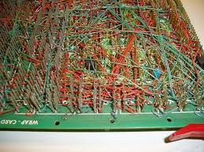
Graphs
A graph is called planar if it can be drawn in a single plane with no edges crossing.
<loved by EE majors for an obvious reason>
A graph in which each vertex is connected to every other vertex is called a clique. Are the following cliques planars?
three-clique?
How about 4-clique?
How about 5-clique?

Slide 9
Graphs
When discussing graphs we use two variables.
V = # of vertices
E = # of edges
Is there any relationship between V and E?

Slide 10
Graphs
Assume that our graph is directed. What is the max # of edges given V?
V^2 (or V(V-1) if you ignore self loops)
Assuming it’s undirected (and no self-loops)?
V(V-1)/2
So E is O(V^2)

Slide 11
Graphs
A graph is called sparse if E is much less than V^2, and is called dense if E is close to V^2
Question: for any airline map between 30 airports in reality, is it dense?
Does Southwest fly 900 routes?

Slide 12
Graph Representations

Slide 13
Graph Representations – Adjacency Matrix
adjacency matrix,
a[i][j] <> 0 ifff i -> j
How about undirected graph?
How about space complexity?
O(V^2)
 | A | B | C | D | E | F
A | 0 | 0 | 1 | 0 | 0 | 0
B | 0 | 0 | 1 | 0 | 0 | 1
C | 0 | 0 | 0 | 1 | 1 | 0
D | 0 | 0 | 0 | 0 | 0 | 0
E | 0 | 0 | 0 | 0 | 0 | 0
F | 0 | 0 | 0 | 0 | 1 | 0
The meaning of “sparse” should be starkly clear in the matrix
A
B
C
D
F
E
May not be symmetric
A
B
C
Always symmetric
D
F
E

Slide 14
Graph Representations – Adjacency List
Adjacency List
A: {C}
B: {C,F}
C: {D,E}
D: {}
E: {}
F: {E}
How about undirected graph?
What is the space complexity?
O(E) space complexity for adjacency list.
A
B
C
D
F
E
A
B
C
D
F
E

Slide 15
Graph Representations - Exercise
 | A | B | C | D | E | F
A | 0 | 0 | 1 | 0 | 0 | 0
B | 0 | 0 | 1 | 0 | 0 | 1
C | 0 | 0 | 0 | 1 | 1 | 0
D | 0 | 0 | 0 | 0 | 0 | 0
E | 0 | 0 | 0 | 0 | 0 | 0
F | 0 | 0 | 0 | 0 | 1 | 0
A: {C}
B: {C,F}
C: {D,E}
D: {}
E: {}
F: {E}
Given the adjacency matrix, answer the following questions.
What is the adjacency list?
Please draw the graph.
Is it a directed graph or an undirected graph?

Slide 16
Graph Representations - Exercise
 | A | B | C | D | E | F
A | 0 | 0 | 1 | 0 | 0 | 0
B | 0 | 0 | 1 | 0 | 0 | 1
C | 0 | 0 | 0 | 1 | 1 | 0
D | 0 | 0 | 0 | 0 | 0 | 0
E | 0 | 0 | 0 | 0 | 0 | 0
F | 0 | 0 | 0 | 0 | 1 | 0
A: {C}
B: {C,F}
C: {D,E}
D: {}
E: {}
F: {E}
Time Complexity:
Given a vertex A, what are the adjacent nodes?
Adjacency matrix:
Adjacency list:
Find if edge A->B exist in the graph?
Adjacency matrix:
Adjacency list:
Always O(V)
Worst-case O(V), depends on the graph sparseness
O(1)
Worst-case O(V)

Slide 17
Graph Representations - Comparison
Space complexity:
Adjacency matrix: O(v^2)
Adjacency list: O(E)
Which one could save more space for a sparse graph?
Time Complexity:
Determining the presence of an edge
Adjacency matrix is faster O(1)
Determining the list of all adjacent nodes
Adjacency list is faster O(V)

Slide 18
Requirements/Expectation
Given a graph, be able to provide its adjacency matrix & adjacency list
Given an adjacency matrix (or adjacency list), be able to draw the graph.
Understand the differences in adjacency matrices/lists for directed graph & undirected graph
Compare adjacency matrix & adjacency list (space and time)

Slide 19
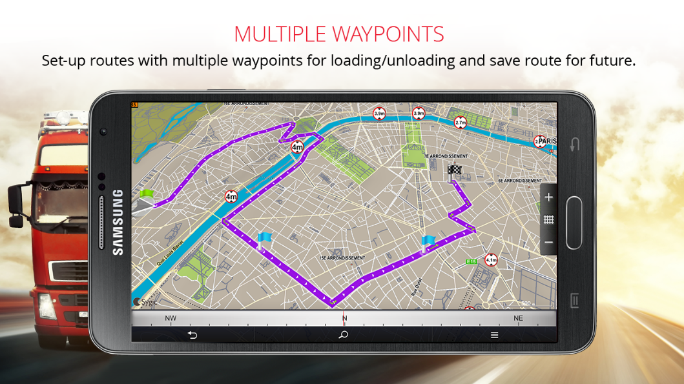
Graphs – When to use it?
Classic problems:
Shortest path?
Traveling salesperson?
Given a list of cities and the distances between each pair of cities, what is the shortest possible route that visits each city exactly once and returns to the origin city?
GPS navigation
A
B
C
D
F
E

Slide 20
Graph Algorithms - Traversal
We want to visit all nodes in a graph.
Challenge: unlike trees
graphs can have cycles,
and more than one way to visit the same node ...
Both issues demand that we avoid visiting the same node
We need to avoid cycles and avoid repeats.
We will solve these problems by marking each vertex.
A
B
C
D
F
E

Slide 21
Graph Algorithms - Traversal
Worklist Algorithm:
Start with an initial point or node, and mark it.
While the worklist is not empty do:
remove a node from the worklist.
print it out.
add all adjacent unmarked nodes to the worklist and mark them.

Slide 22
Graph Algorithms - Traversal
Let’s start a stack for our worklist.
<Start at A, mark it, add it to the list, remove it, add and mark the adjacent ones, remove the last one added, ... continue.>
<We just covered depth-first search/traversal, DFS>
A
B
C
D
F
E

Slide 23
Graph Algorithms - Traversal
Let’s start a queue for our worklist.
<Start at A, mark it, add it to the list, remove it, add and mark the adjacent ones, remove the next one added, ... continue.>
<We just covered breadth-first search/traversal, BFS>
A
B
C
D
F
E

Slide 24
Graph Algorithms
<Show BFS and DFS against a tree to clarify the meaning>
If stack?
If queue?
A
a
B
D
a
C
a
a
E
F
a
a
G
a

